Slide 1
Trainer’s Connect
01
More teaching.
Less chasing.
Built by a trainer,
for trainers + their AI assistants.
Workflow prototype today. AI assistant vision next. / October 2026
Notes:
Positioning requested by the owner: built by a trainer, for trainers + their AI assistants. The owner clarified that agent means AI assistant. Current workflow prototype is real local software. AI is planned, with no live sidebar or autonomous actions. Product evidence: project documents 21, 27 and 28, checked 19 October 2026.

Slide 2
Trainer’s Connect
02
THE PROBLEM
The admin around every training day
01
Dates that look busy
can still be at risk
Overlapping enquiries and unclear commitments
make sellable capacity hard to read.
02
The latest agreement
is buried in a chat
Confirmations, venue changes and outline
revisions sit in different conversations.
03
The next step depends
on someone remembering
Preparation and follow-up need a visible owner
after the booking is confirmed.
Notes:
These qualitative problems come from the owner’s Malaysia freelance corporate training workflow. No survey prevalence, quantified loss, market sizing or measured ROI is claimed.

Slide 3
Trainer’s Connect
03
HRD CORP TIMING / BUSINESS RISK
Missed opportunities and dead slots
01
A run waits on approval
Grant timing or paperwork can leave the date
decision unresolved.
02
Another enquiry moves on
The trainer may pass on competing work while
waiting for clarity.
03
A late change leaves a gap
If the run moves late, the dead slot may be hard
to refill.
Illustrative risk. Grant approval and commercial booking confirmation are separate.
Notes:
Illustrative business risk based on the owner’s workflow, not a measured claim that HRD Corp causes cancellations. Official source rechecked 20 October 2026: https://hrdcorp.gov.my/hrdcorp-claimable-courses . The notice distinguishes in-house and public training and approval-based lead periods. Do not confuse the owner’s 14-day lock or 21-day dead-slot indicator with universal HRD Corp rules. For a trusted TP, a booking can already be confirmed while grant/PO paperwork remains open. The app does not assess eligibility or submit to e-TRiS.

Slide 4
Trainer’s Connect
04
THE VALUE PROPOSITION
Clarity for the whole training run
Protect your sellable dates
Know which enquiries are standbys, protected holds or confirmed work.
Keep the work moving
One agreed run, with preparation, delivery and the next action attached.
Designed to reduce avoidable clashes and repeated chasing. Pilot results still to be measured.
Notes:
Benefits are intended outcomes, not measured customer results. Working local features include bookings/holds, shared preparation and separate delivery/follow-up. No income guarantee.

Slide 5
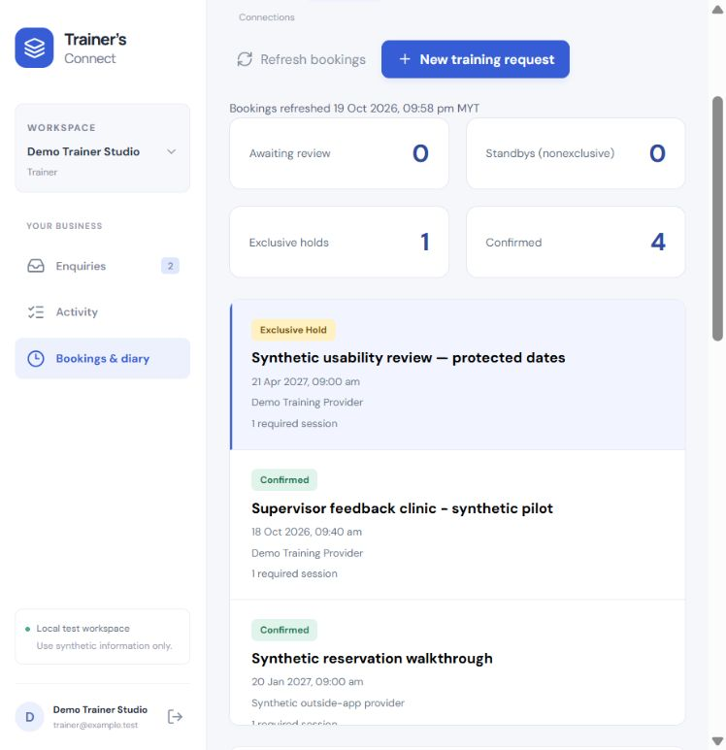
Trainer’s Connect
05
PROTECT THE DATE
Every date has a clear meaning
Manual standby
Flexible, nonexclusive and released manually.
Exclusive timed hold
Explicitly protect the dates until the
reviewed deadline.
Confirmed booking
Actual synthetic prototype. Live calendar synchronisation is not connected.
Notes:
Screenshot: actual local synthetic prototype captured 19 October 2026. D22 manual nonexclusive standby never auto-expires. Timed exclusive hold is explicitly chosen and expires through the worker. Confirmation requires the selected consent/evidence policy. This protects capacity recorded in this app, not unsynchronised external calendars.

Slide 6
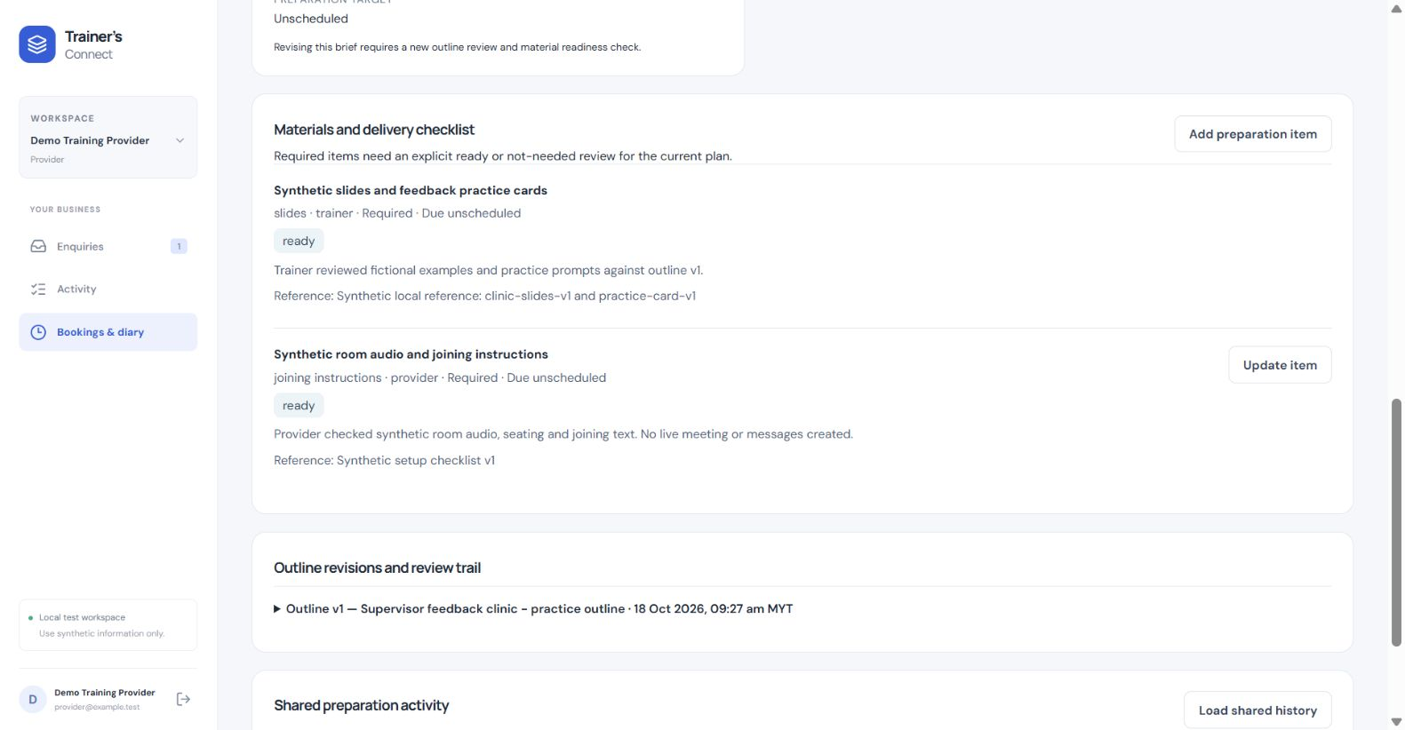
Trainer’s Connect
06
PREPARE TOGETHER
One shared plan for delivery
A brief both sides can review
Versioned outlines keep approvals
tied to the plan people
actually reviewed.
Materials have an owner and an
explicit readiness status.
Shared run details stay separate from private enquiries and internal notes.
Notes:
Screenshot: actual synthetic provider preparation walkthrough, 18 October 2026. Shared brief versions, outline review and responsibility-scoped materials readiness work locally. No file uploads or live message delivery.

Slide 7
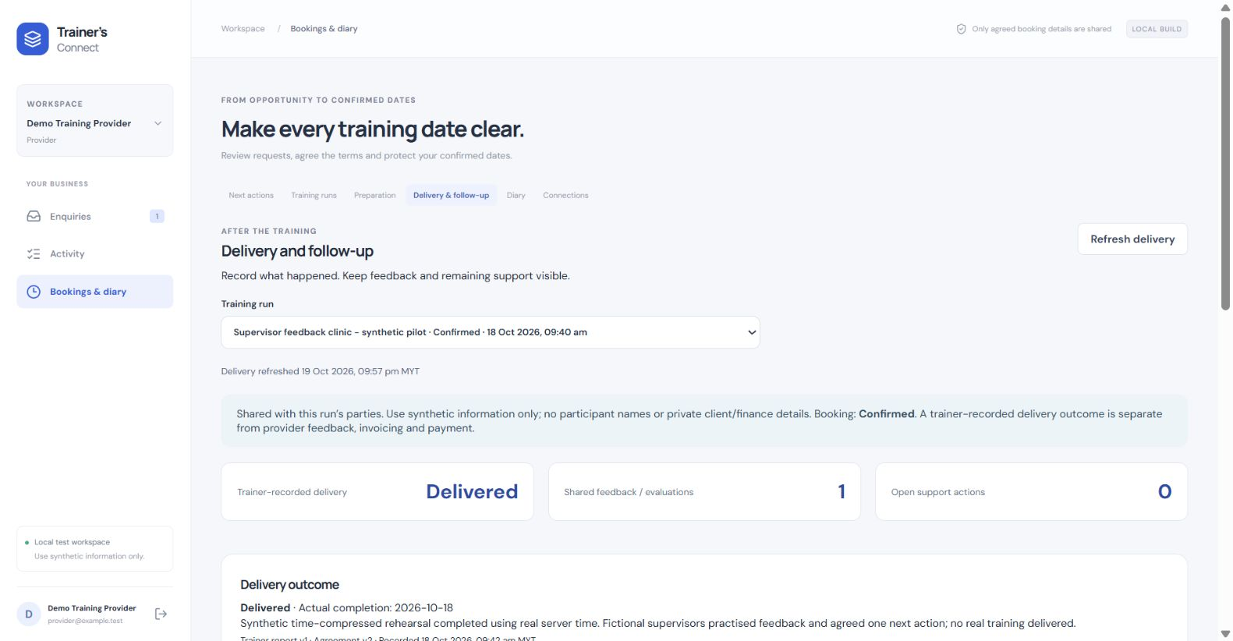
Trainer’s Connect
07
CLOSE THE LOOP
The work continues after the workshop
Delivery has its own record
Keep the outcome, shared feedback and
remaining support attached to the run.
An owner and next step
keep follow-up visible.
Actual synthetic prototype. A delivered run does not mean an invoice has been paid.
Notes:
Screenshot: actual synthetic provider delivery view, captured 19 October 2026. Trainer records delivery; both sides can contribute shared evaluation and scoped support actions. Booking confirmation, delivery and payment remain separate. Finance is not implemented.

Slide 8
Trainer’s Connect
08
THE WORKFLOW
A working record for every enquiry
01
02
03
Enquiry
Reservation
Confirmation
Capture the conversation
Standby or explicit hold
Record the agreement
04
05
06
Preparation
Delivery
Follow-up
Review the brief and outline
Record what happened
Keep the next step visible
Notes:
The labels show the supported local workflow, not a claim that every enquiry will convert. Manual standby can remain nonexclusive; exclusive timed hold is optional and explicit. Enquiry logging never reserves dates.

Slide 9
Trainer’s Connect
09
BENEFICIAL USE CASE / WORKING PROTOTYPE
Two requests for one date
A trainer has two enquiries for one day. Neither provider has confirmed.
Benefit: The trainer sees commitment clearly. Providers know whether dates
have protection.
01
02
03
04
Log the enquiries
Choose a standby
Protect the dates
Confirm the run
Keep each lead in its
private workspace.
Manual standbys may
share the same date.
Choose an exclusive
hold and review
its deadline.
Required consent and
conflict checks decide
the booking.
A competing exclusive hold is blocked. Manual standby never expires automatically.
Notes:
Illustrative scenario, not a customer testimonial. A trainer has two enquiries for one day. Neither provider has confirmed. Benefit: The trainer sees commitment clearly. Providers know whether dates have protection. A competing exclusive hold is blocked. Manual standby never expires automatically.

Slide 10
Trainer’s Connect
10
BENEFICIAL USE CASE / MANUAL COORDINATION TODAY
Grant timing and date risk
An in-house run awaits grant approval while another provider asks for the trainer’s date.
Benefit: Review date risk earlier, while keeping booking consent separate from
grant approval.
01
02
03
04
Log the
pending item
Review the
grant timing
Choose the mode
Record the decision
Use a private next action
for the grant chase.
Verify grant timing
outside the app.
Choose manual standby
or an explicit timed hold.
Confirm under the
agreed policy, or agree
a change.
Grant approval is separate from booking consent. No e-TRiS connection or automatic eligibility check.
Notes:
Illustrative scenario, not a customer testimonial. An in-house run awaits grant approval while another provider asks for the trainer’s date. Benefit: Review date risk earlier, while keeping booking consent separate from grant approval. Grant approval is separate from booking consent. No e-TRiS connection or automatic eligibility check. Source checked 2026-10-20: https://hrdcorp.gov.my/hrdcorp-claimable-courses

Slide 11
Trainer’s Connect
11
BENEFICIAL USE CASE / WORKING PROTOTYPE
A brief changes before delivery
A provider revises the audience or learning objectives after the first outline review.
Benefit: Both sides prepare against the reviewed version, with responsibilities visible.
01
02
03
04
Revise the brief
Update the outline
Review the plan
Check the materials
Record the shared
audience and objectives.
Publish a new revision
for review.
The required parties
approve the
current version.
Each side reviews its own
assigned items.
A changed brief requires renewed outline and materials review. Approval does not confirm a booking.
Notes:
Illustrative scenario, not a customer testimonial. A provider revises the audience or learning objectives after the first outline review. Benefit: Both sides prepare against the reviewed version, with responsibilities visible. A changed brief requires renewed outline and materials review. Approval does not confirm a booking.

Slide 12
Trainer’s Connect
12
BENEFICIAL USE CASE / WORKING PROTOTYPE
Follow-up after the workshop
The workshop has ended. Feedback and a provider support task still need attention.
Benefit: The next action stays attached to the run, with an owner and a visible status.
01
02
03
04
Record delivery
Share the feedback
Assign the follow-up
Close with a note
The trainer records the
actual outcome.
Both sides can add a
shared summary.
Give the support task an
owner and due date.
The responsible side
records completion.
Booking confirmation, delivery and payment remain separate. No finance workflow is live.
Notes:
Illustrative scenario, not a customer testimonial. The workshop has ended. Feedback and a provider support task still need attention. Benefit: The next action stays attached to the run, with an owner and a visible status. Booking confirmation, delivery and payment remain separate. No finance workflow is live.

Slide 13
Trainer’s Connect
13
FOR BOTH SIDES
Trainer and provider
work from one agreement
For the trainer
For the provider
See commitment clearly.
Prepare against the agreed version.
Keep support promises visible.
Coordinate the run.
Review the outline.
Track the work assigned to your side.
Each workspace keeps its private enquiries and internal notes.
Notes:
Equal priority for trainer/provider is approved D01. Private enquiry visibility and shared engagement permissions are tested locally. No shared financial pricing or margins functionality is claimed.

Slide 14
Trainer’s Connect
14
BENEFICIAL USE CASE / PLANNED AI ASSISTANCE
AI drafts the next chase
A trainer wants a short briefing and a draft follow-up before starting the day.
Benefit: The intended benefit is less preparation for routine admin, with the trainer
in control.
01
02
03
04
Choose the context
Summarise the work
Prepare a draft
Trainer decides
The trainer controls
which records the
assistant may use.
The assistant would
highlight what
needs attention.
A proposed follow-up
stays ready for review.
The trainer reviews any
next action before
it happens.
This flow is planned. No AI account, live message sending or autonomous action is connected.
Notes:
Illustrative scenario, not a customer testimonial. A trainer wants a short briefing and a draft follow-up before starting the day. Benefit: The intended benefit is less preparation for routine admin, with the trainer in control. This flow is planned. No AI account, live message sending or autonomous action is connected.

Slide 15
Trainer’s Connect
15
WHERE THE PRODUCT STANDS
A working local foundation
60
Durable enquiries and accounts
Concurrent booking conflict checks
Worker-driven hold expiry
Preparation and delivery workflow
Restart persistence
API integration tests passed
19 October 2026
Verified locally with synthetic data. Public product launch and production certification are still ahead.
Notes:
Evidence: product document 28. Raw API regression 2026-10-19-final-regression.txt: 60/60 pass, 82192.3771 ms. 19 passing Chrome assertions, one viewport harness failure with passing rerun. Existing backup/restore proof is a bounded clean local environment check in document 26. These checks do not establish production security or business ROI.

Slide 16
Trainer’s Connect
16
PRODUCT DIRECTION
The next chapter follows real use
01
Now: workflow prototype
Bookings, preparation, delivery and follow-up in
a local synthetic environment.
02
Next: policy and pilot review
Resolve operating policies and review realistic
daily use.
03
Later: integrations and AI
Connect chosen tools, with controlled
permissions and human review.
Finance, pricing and production rollout remain separate decisions.
Notes:
Proposed roadmap only. Owner decisions P01-P05 remain open. Finance, live connectors, deployment of the core product and AI actions require separate approval and evidence. The separately authorised marketing waiting-list site is not deployment of the core training app. No launch date or pricing is promised.

Slide 17
Trainer’s Connect
17
JOIN THE WAITING LIST
Your training reality
shapes the next version
Built by a trainer.
For trainers + their
AI assistants.
Pilot and launch updates
trainers-connect-waitlist.lifeisagame.chatgpt.site
Notes:
The owner requested a public Sites waiting-list page on 19 October 2026. Signup collects required email, optional name and explicit consent. It does not promise pilot access, pricing or a launch date. No automatic confirmation email is sent.

Slide 18
Trainer’s Connect
18
TECHNICAL APPENDIX
Open foundations, controlled source access
The core uses open-source components
React + Vite
NestJS + TypeScript
PostgreSQL
Application source stays private.
Cal.diy is a design reference.
Its code is not a runtime dependency.
Source folders, repository access and upstream licence links are listed in the separate owner guide.
Notes:
Source/license references checked 19 October 2026. React MIT: https://github.com/react/react/blob/main/LICENSE ; NestJS MIT: https://github.com/nestjs/nest/blob/master/LICENSE ; Vite MIT: https://github.com/vitejs/vite/blob/main/LICENSE ; TypeScript Apache-2.0: https://github.com/microsoft/TypeScript/blob/main/LICENSE.txt ; PostgreSQL licence: https://www.postgresql.org/about/licence/ . Cal.diy MIT pinned reference: https://github.com/calcom/cal.diy/blob/54343aa685ae8f33159d2f485ec4a57bad5c574a/LICENSE . Cal.diy is studied as a design/test reference, not installed or copied into this app. The current app Git repository is private; no root project licence was found. Do not describe the whole app as publicly open source. Full local access map is in the marketing folder SOURCE-AND-ACCESS.md, excluded from hosted marketing downloads.

